Slide 1
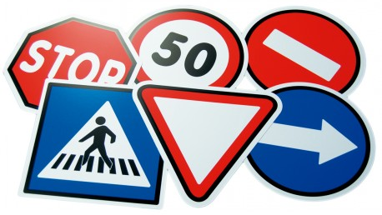
Traffic Sign Detection
Naman Thakur (12017949) (14)
Siddharth Mehrotra (12006050) (3)
Sameer Ahmad Khan (12017912) (13)

Slide 2
Traffic Sign Detection
Naman Thakur (12017949) (14)
Siddharth Mehrotra (12006050) (3)
Sameer Ahmad Khan (12017912) (13)

Slide 3

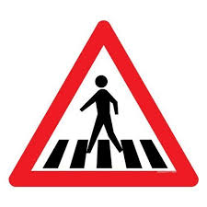




Introduction
There are several different types of traffic signs like speed limits, no entry, traffic signals, turn left or right, children crossing, no passing of heavy vehicles, etc. Traffic signs classification is the process of identifying which class a traffic sign belongs to.
In this Python project example, we will build a deep neural network model that can classify traffic signs present in the image into different categories. With this model, we are able to read and understand traffic signs which are a very important task for all autonomous vehicles.
When you go on the road, you see various traffic signs like traffic signals, turn left or right, speed limits, no passing of heavy vehicles, no entry, children crossing, etc., that you need to follow for a safe drive. Likewise, autonomous vehicles also have to interpret these signs and make decisions to achieve accuracy. The methodology of recognizing which class a traffic sign belongs to is called Traffic signs classification.
In this Deep Learning project, we will build a model for the classification of traffic signs available in the image into many categories using a convolutional neural network(CNN) and Keras library.

Slide 4

The motivation behind choosing a project on traffic sign recognition system is to address the issue of road safety and traffic management. The traffic sign recognition system can help drivers and autonomous vehicles to understand the road environment better and make informed decisions based on the information provided by the traffic signs. Accidents due to human error and lack of attention can be reduced by alerting drivers to speed limits, stop signs, construction zones, and other road hazards. With the increasing number of vehicles on the road, it becomes essential to manage traffic efficiently and safely. The project aims to contribute to the development of safer and more efficient transportation systems. The use of neural networks and deep learning techniques can help achieve high accuracy in recognizing traffic signs, making the project valuable to the field of image processing and transportation systems.
Motivation of choosing our topic

Slide 5
Challenges faced
Class Imbalance
Images of different sizes
Overfitting to the majority class

Slide 6
Applications of the project
Driver Assistance
Pedestrian Safety
Special needs assistance
Autonomous Cars
Road Safety
Traffic Management
Navigation
Transport planning
Smart Cities

Slide 7
Related work
S. No. | Author | Technique Used | Dataset Used | Evaluation Parameters | Pros | Cons
1. | Sun et al.[1] | Hough Transform | Chinese Traffic Sign Dataset | 98.2% Accuracy | Noise and curve discontinuity have relatively small influence. | The biggest disadvantage of mean filtering.
2. | Franzen et al.[2] | Traffic sign recognition does not take place in the spatial domain but in the frequency domain. | German Traffic sign Recognition Benchmark (GTSRB) | 99.6% Accuracy | Simplifying the neural architecture, as the number of layers can be significantly reduced. | Some images may be misinterpreted in the frequency domain.
3. | Manzari et al.[3] | Hinge loss stochastic gradient descent technique. | European Traffic Sign Dataset | 99.51% Accuracy | The networks have good resistance to adversarial attacks, which is interesting as future works. | One of the factors that reduce network accuracy and image degradation is rotation.
4. | Razdak et al.[4] | Proposed method extracted the detected sign in black and white pixels and further classified into groups. | Template dataset. | 94% Accuracy | The dataset contains images with several angles which makes it unique from others. | Presence of other objects in the scene such as moving cars, bicycles, pedestrians, shop signs also offer obstruction in detection.

Slide 8
Proposed Method
Loading and Preprocessing Images
The input images are first loaded into the program and preprocessed using techniques such as resizing, normalization, and data augmentation to increase the dataset's diversity.
Fine-tuning the Pre-trained Model
The pre-trained EfficientNetB3 model is used as the base model and fine-tuned on the traffic sign dataset using transfer learning. This involves removing the final layer of the model and replacing it with a new output layer that has the same number of neurons as the number of classes in the dataset.
Training the Model
The fine-tuned model is then trained on the preprocessed images using backpropagation and gradient descent algorithms to optimize the model's parameters.
Testing the Model
Prediction
The trained model is then evaluated on the test dataset to measure its performance in accurately classifying new images.
Once the model is trained, it can be used to predict the class of new traffic sign images in real-time.

Slide 9
Flowchart of Proposed Method
Data Extraction
Data Division
Preprocessing
Training
Model Selection
No
Validation
Yes
Testing
Results

Slide 10
Key Concept Used-
ReLU- ReLU stands for Rectified Linear Unit, which is a type of activation function used in artificial neural networks. The ReLU function is defined as f(x) = max(0,x), which means that it outputs the maximum of 0 and the input value x.
ADAM- Adam is a popular optimization algorithm used for training deep neural networks. The name "Adam" stands for "Adaptive Moment Estimation," which refers to the adaptive learning rate and the use of the first and second moments of the gradients during the optimization process.
Epochs- In machine learning, an epoch is a complete pass over a training dataset by a learning algorithm during the training process. In other words, it refers to the number of times the learning algorithm has iterated through the entire dataset during training.

Slide 11
Batch Size- In image processing and other machine learning tasks, the batch size refers to the number of training examples (images or samples) used in a single iteration of the learning algorithm.
Batch Normalisation - Batch normalization is a technique used in deep neural networks to improve the training process and the performance of the model. It involves normalizing the input data to each layer of the network to have zero mean and unit variance, which helps to stabilize the training process and reduce the impact of changes in the distribution of the input data.
Accuracy- In image processing, accuracy can also be calculated using the true positive (TP), true negative (TN), false positive (FP), and false negative (FN) values. These values are typically obtained from a confusion matrix, which is a table that summarizes the performance of a classification model on a dataset. The formula for accuracy using TP, TN, FP, and FN is: Accuracy = (TP + TN) / (TP + TN + FP + FN)

Slide 12
Pre-Processing-
Pre-processing is a critical step in image processing that involves manipulating and transforming images before they are fed into the machine learning algorithm for training or testing. Here are the typical steps involved in preprocessing an image for the traffic sign recognition system project:
Load the image
Resize the image
Apply image normalization
Apply image augmentation
Label the image
Save the pre-processed image
Overall, the goal of pre-processing is to standardize the images and extract meaningful features that can be used by the machine learning algorithm to classify new images accurately.

Slide 13
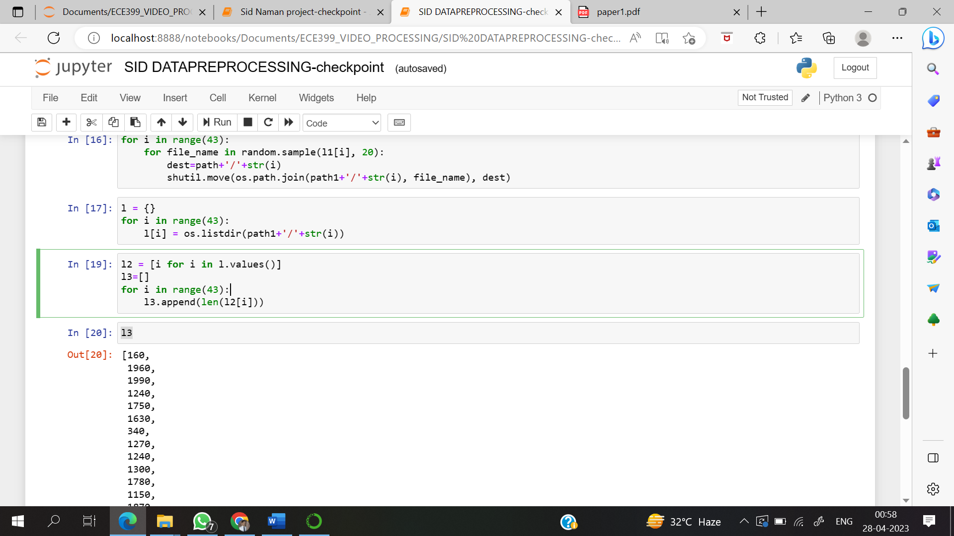

Slide 14
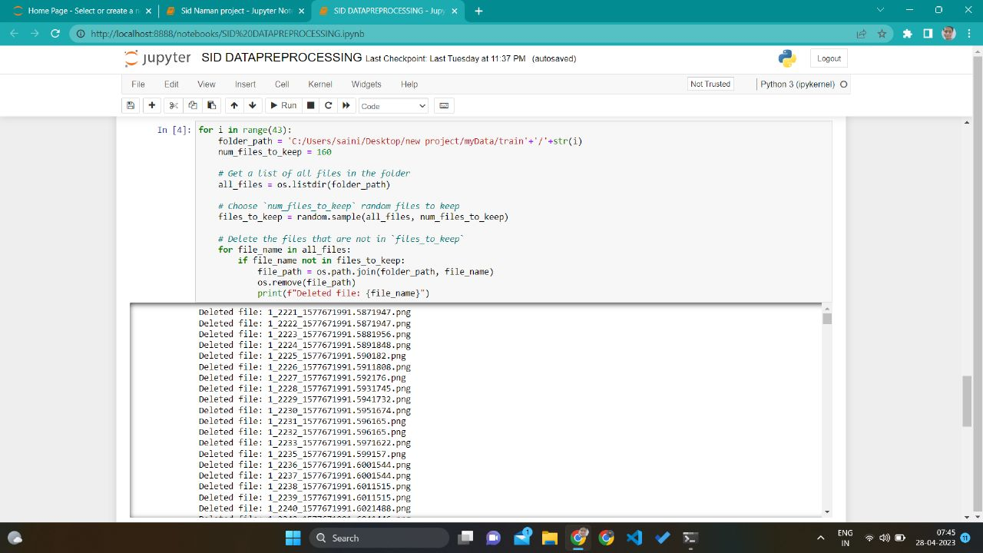

Slide 15
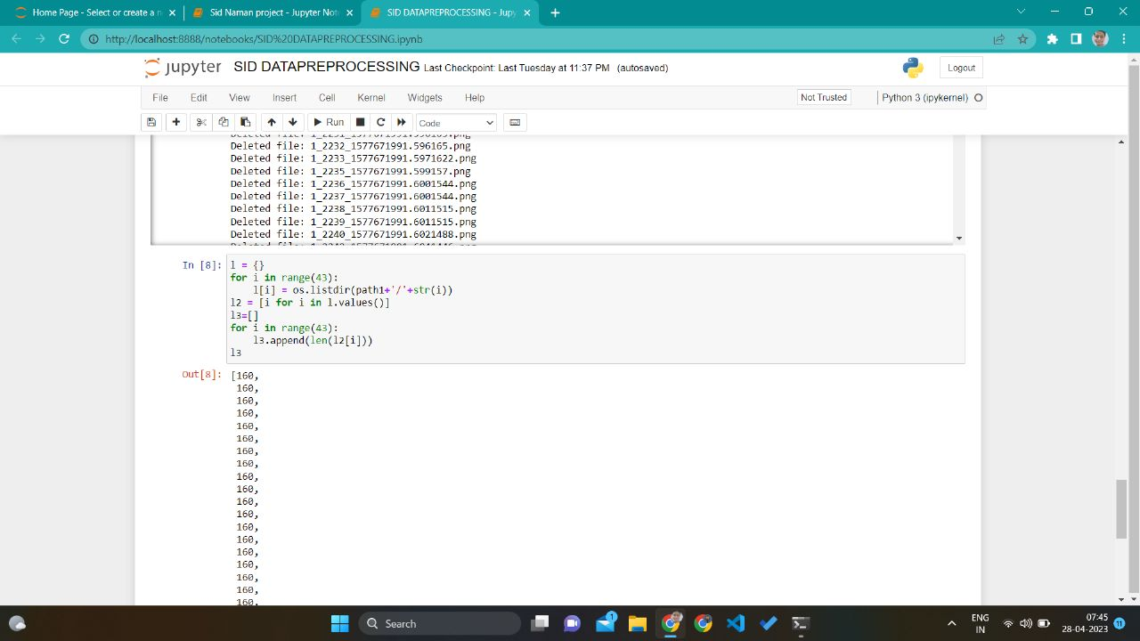

Slide 16
After pre-processing

Slide 17
Feature Extraction-
Feature extraction is a crucial step in an image processing project that involves extracting relevant features from images to create a representation that can be used for training and testing a machine 17 learning model such as a neural network. In the case of the project that uses the EfficientNetB3 neural network, the following feature extraction steps can be performed:
Load the pre-processed data
Extract features using the EfficientNetB3 model
Flatten the features
Split the data into training and testing sets
Save the features and labels

Slide 18
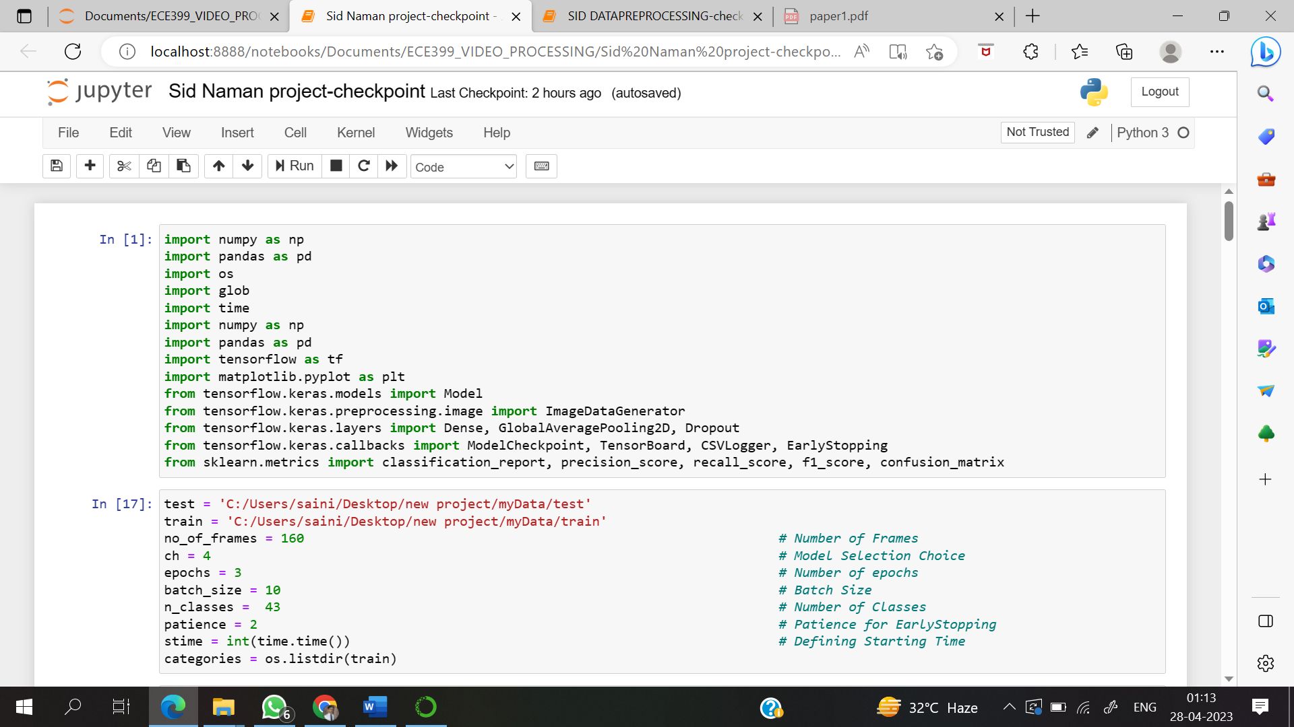

Slide 19
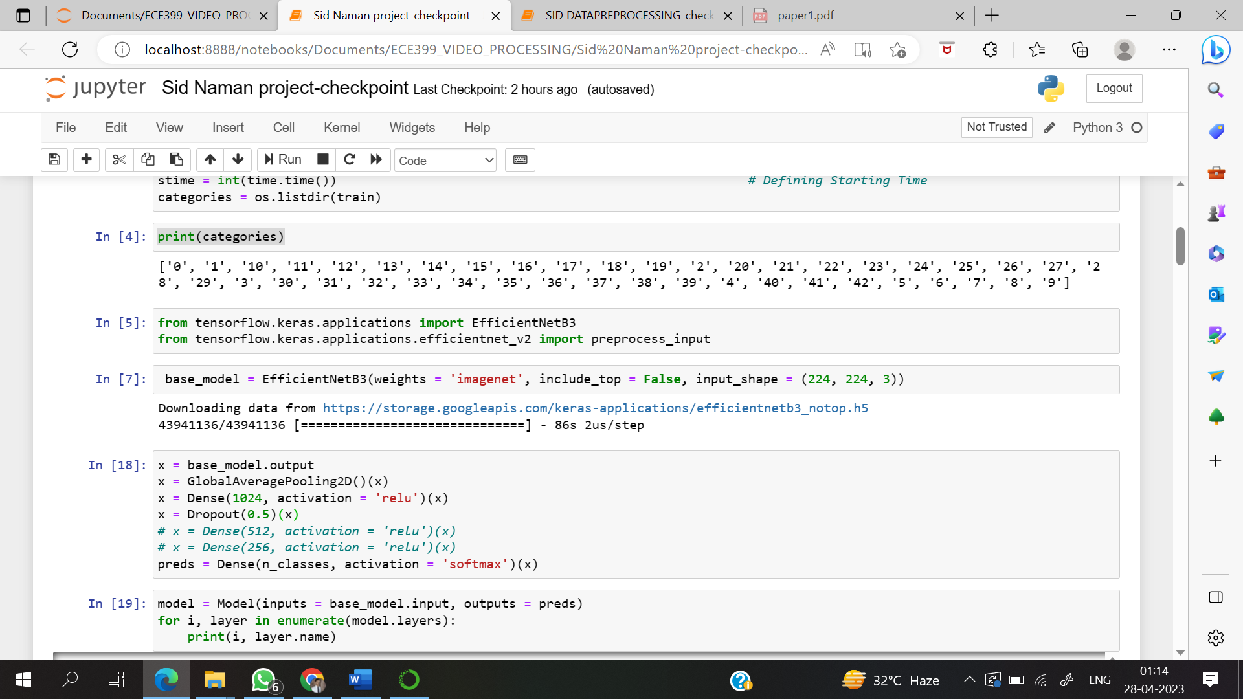

Slide 20
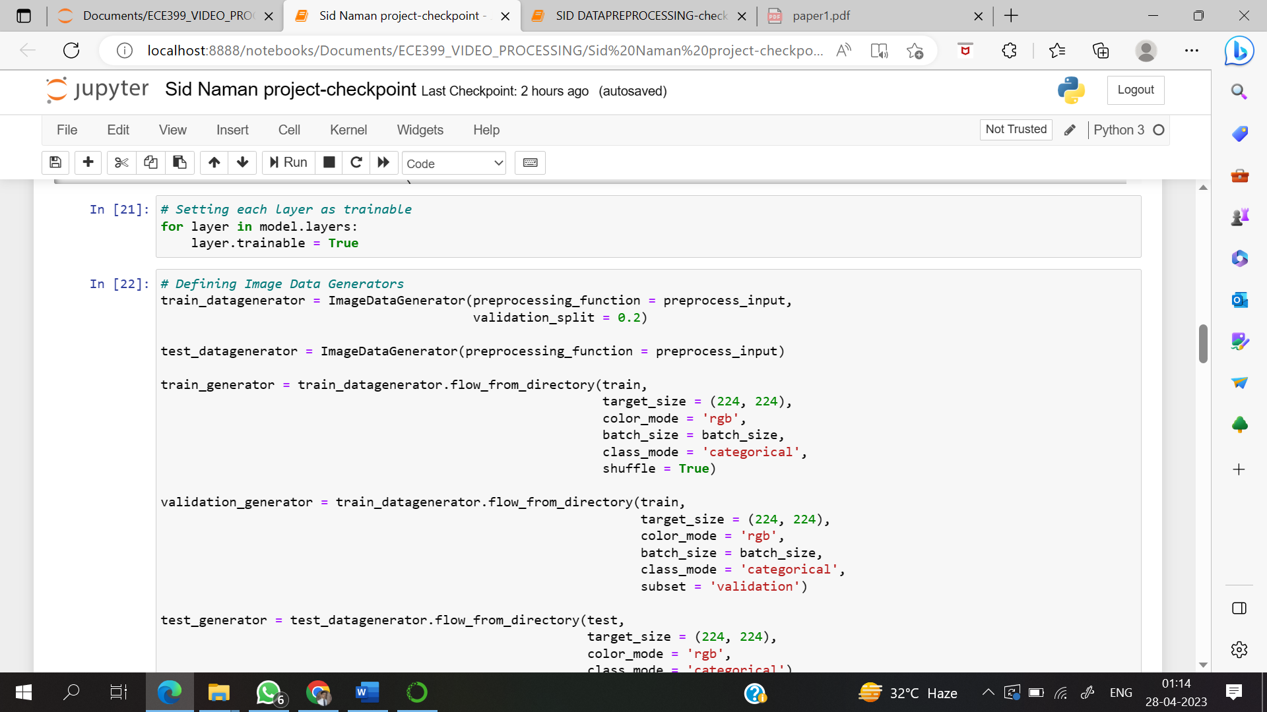

Slide 21
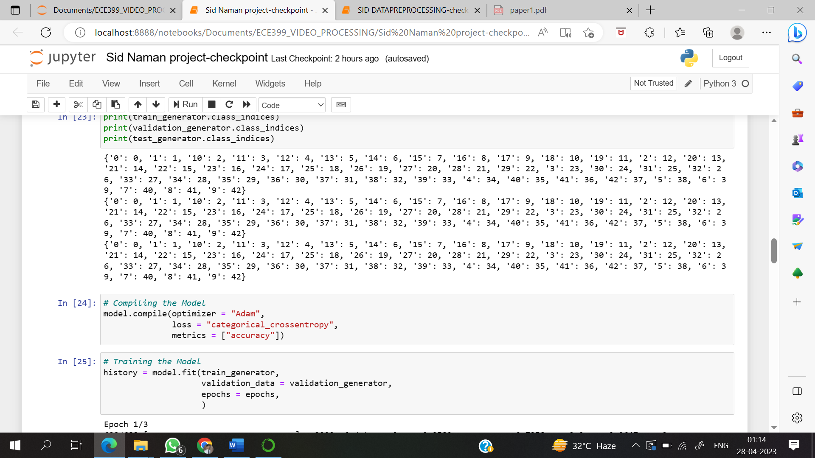

Slide 22
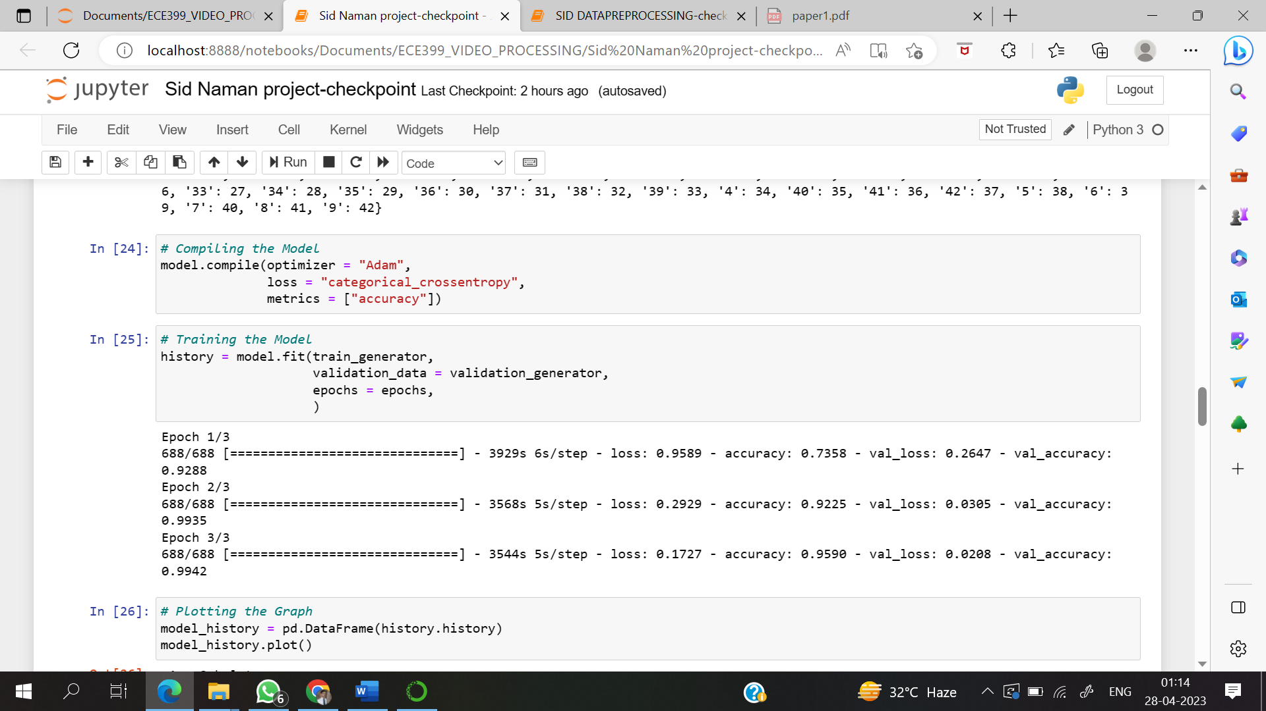

Slide 23
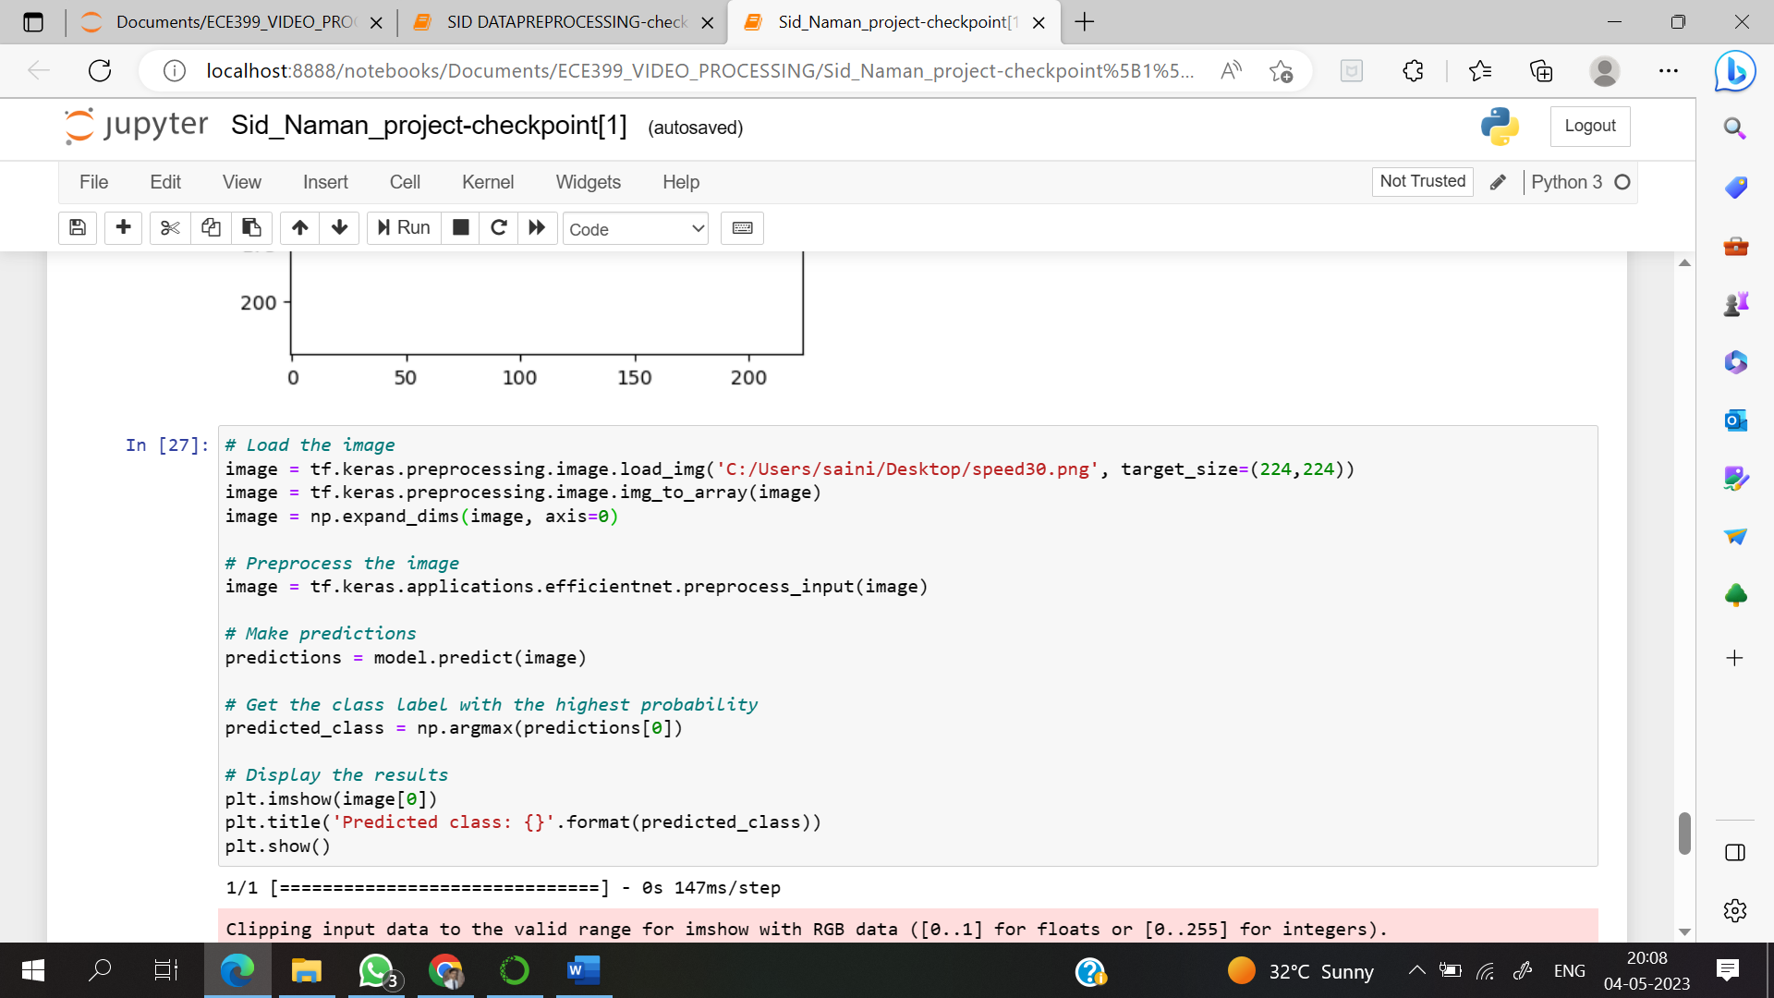

Slide 24
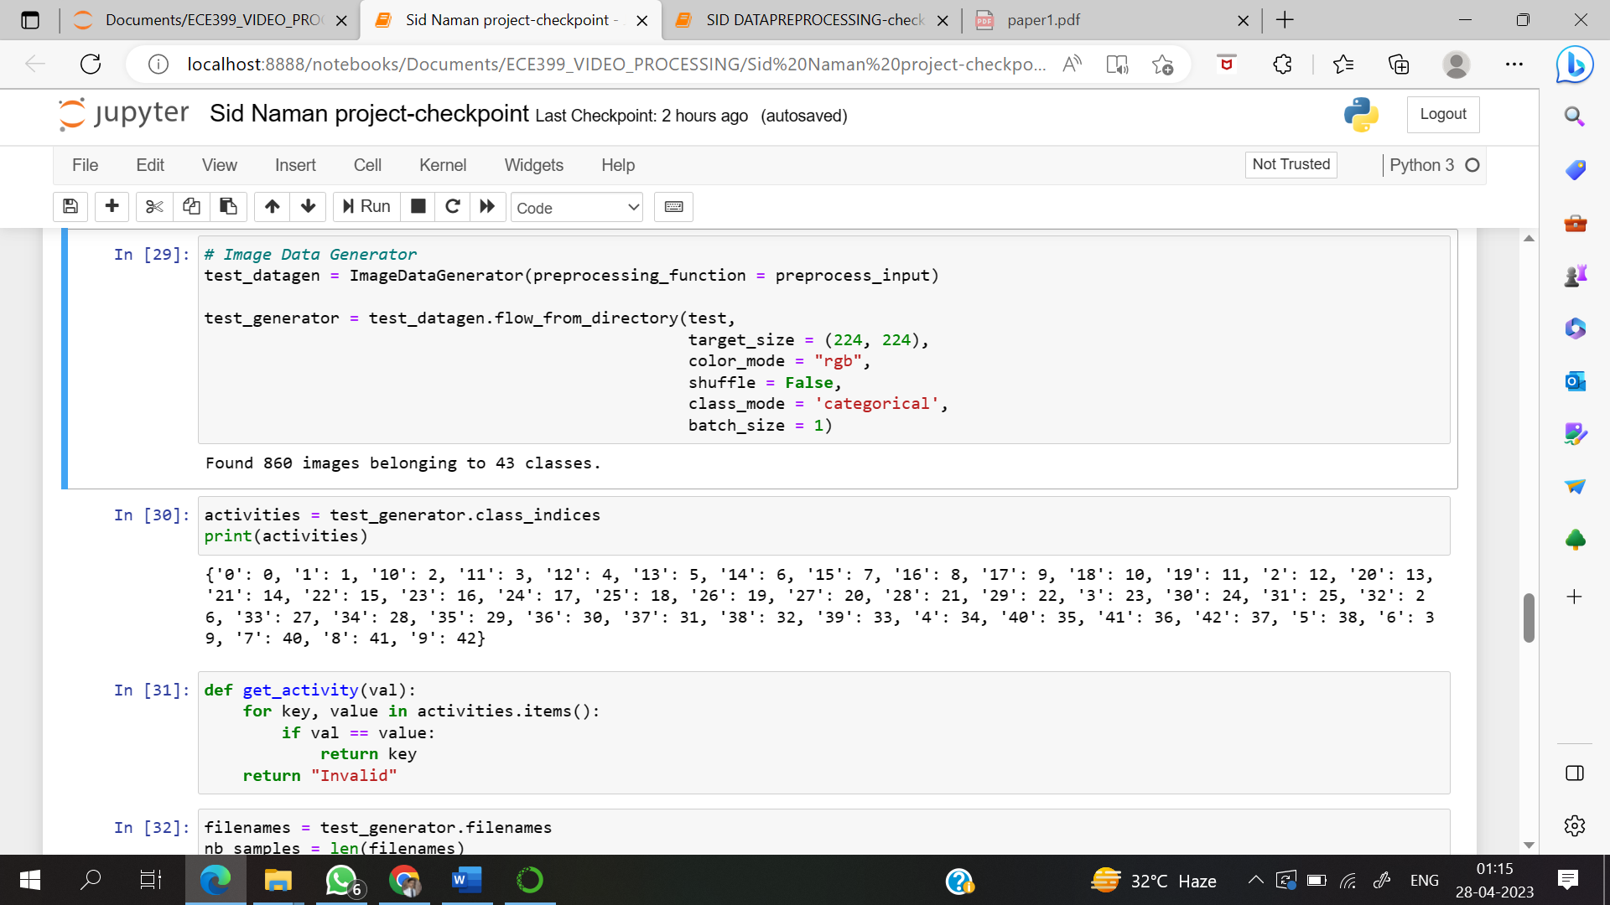

Slide 25
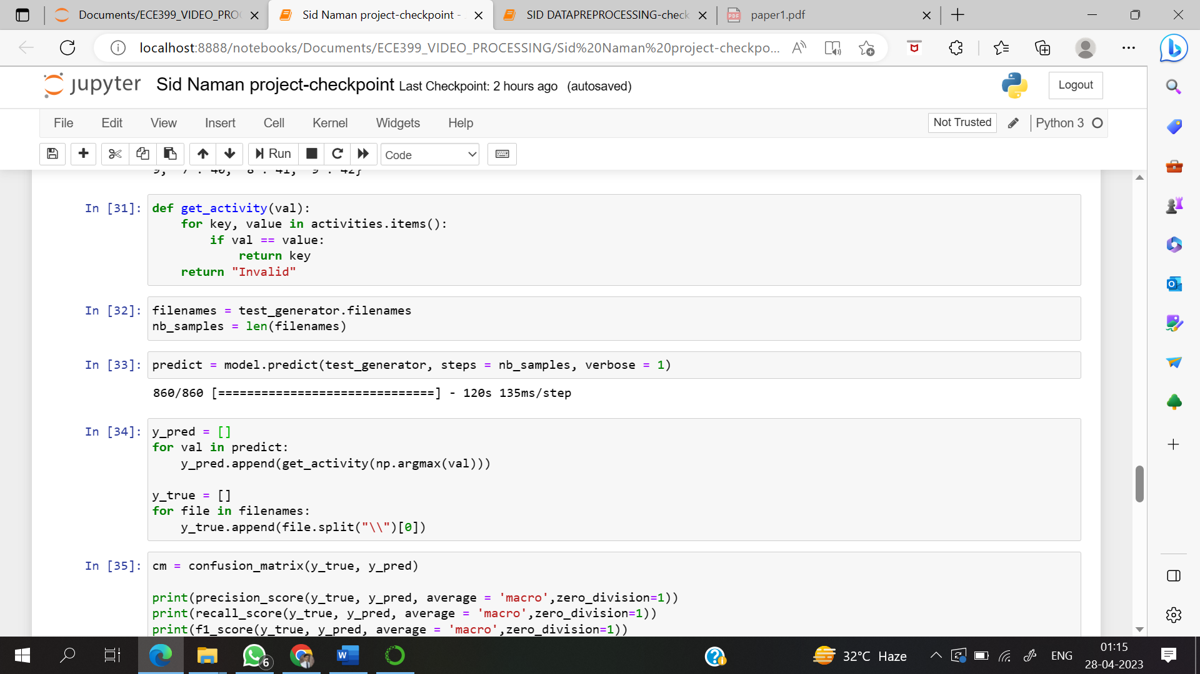

Slide 26
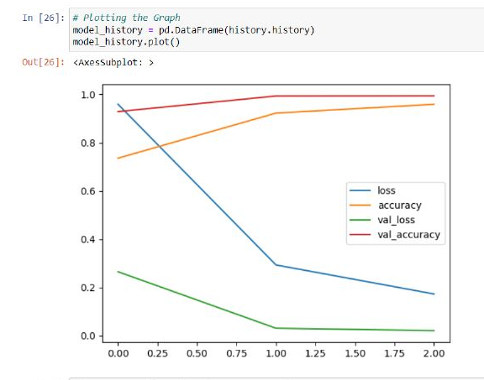
Accuracy Graph

Slide 27
Dataset Description
The proposed method is implemented using python.
The proposed method is tested on GTSRB - German Traffic Sign Recognition Benchmark
Dataset link- https://www.kaggle.com/datasets/meowmeowmeowmeowmeow/gtsrb-german-traffic-sign
This dataset have 43 classes.
This dataset contains total of 34,560 images.
6880 images were used to train the proposed method.
1376 images were used for validation.
860 images were used to test the proposed method.

Slide 28
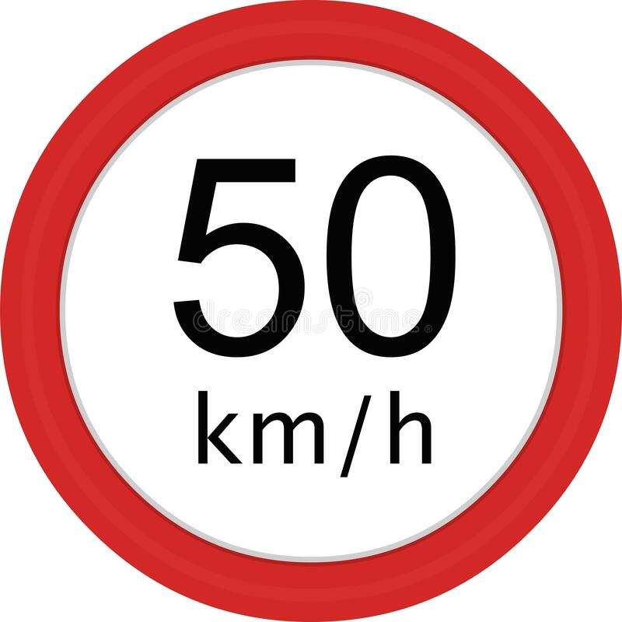
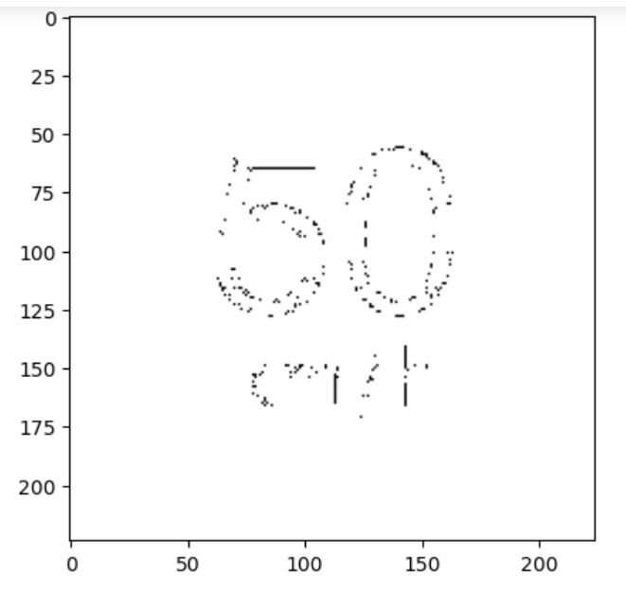

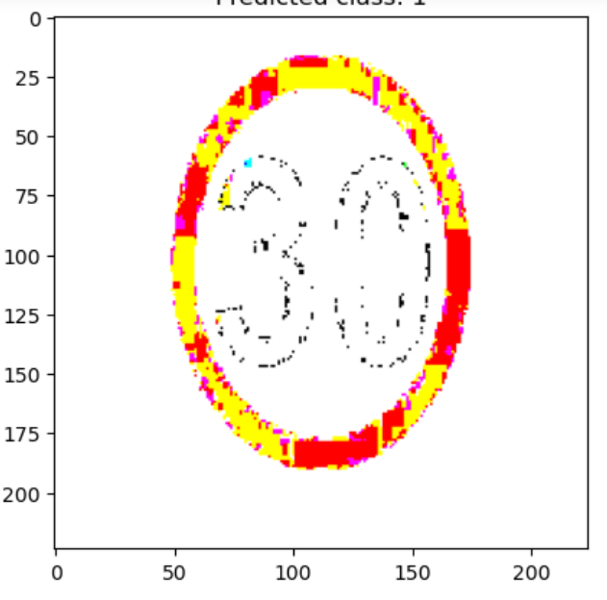
Input/Output Images Table
S. N.
Input Images
Output Images
1.
2.

Slide 29
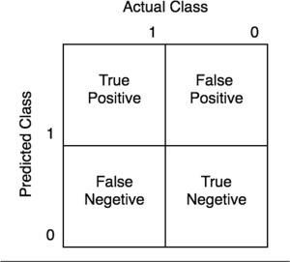

Confusion Matrix
A confusion matrix is a table that summarizes the performance of a machine learning model on a classification problem. It is a matrix of actual versus predicted class labels, and it is used to evaluate the accuracy of the model's predictions. A confusion matrix is typically used in binary classification problems, where there are two possible class labels (positive and negative). The matrix has four possible outcomes:
True Positive (TP): The model correctly predicted a positive example as positive.
False Positive (FP): The model incorrectly predicted a negative example as positive.
True Negative (TN): The model correctly predicted a negative example as negative.
False Negative (FN): The model incorrectly predicted a positive example as negative.
$$Accuracy=\frac{TP+TN}{TP+TN+FP+FN}$$

Slide 30

Results and Discussion

Slide 31
Conclusion
Practical knowledge means the visualization of the knowledge, which we read in our books. For this, we perform experiments and get observations. Practical knowledge is very important in every field. One must be familiar with the problems related to that field so that he may solve them and become a successful person.
After achieving the proper goal in life, an engineer must enter professional life. According to this life, he must serve an industry, may be public or private sector or self-own. For efficient work in the field, he must be aware of practical knowledge as well as theoretical knowledge.
In conclusion, the image processing project involved training a neural network called EfficientNetB3 on a dataset of 43 traffic sign classes, with each class consisting of 160 training images and 20 test images. The project used various Python concepts such as listdir, mkdir, directory, and dictionaries to preprocess the images, extract features, and generate predictions.

Slide 32
The results of the project showed that the EfficientNetB3 neural network achieved high accuracy in predicting the traffic sign classes, with an overall accuracy of 95.9%. The project demonstrated the effectiveness of deep learning in image processing tasks and its potential to be applied in various real-world applications such as autonomous driving systems.
However, there is still room for improvement in the project. The dataset used in the project was relatively small, which may limit the performance of the neural network. Additionally, more advanced techniques such as data augmentation and transfer learning could be employed to improve the performance of the neural network.
Overall, the image processing project provided a valuable learning experience and highlighted the importance of careful data preparation, feature extraction, and model selection in deep learning projects.

Slide 33
Future Scope
The above image processing project on traffic sign recognition using EfficientNetB3 neural network has shown promising results with high accuracy. However, there is still room for improvement and further work can be done to enhance the performance of the system. Some possible future scopes of the project are:
•
•
• •
Large dataset: A larger dataset can be used to train and test the model, which can further improve the performance of the system.
Advanced image processing techniques: Advanced image processing techniques such as data augmentation, image enhancement, and denoising can be used to improve the quality of the input images and increase the robustness of the system.
Transfer learning: The use of transfer learning can be explored, where a pre-trained model on a similar task can be used as a starting point to train the neural network on this task.
Real-time application: The developed model can be integrated into a real-time application for traffic sign recognition, which can be used in self-driving cars or other intelligent transportation systems.
Multi-class object detection: The project can be extended to multi-class object detection where the model can detect and recognize multiple objects in an image such as pedestrians, cars, and traffic signs simultaneously.
Overall, the above project has a lot of potential for further improvement and can be extended in several ways to enhance its performance and expand its applicability to other related fields.

Slide 34
References
Image Processing Commands−
https://optimization.cbe.cornell.edu/index.php?title=Adam#:~:text=Adam%20optimizer%20is%20the%20extended,was%20first%20introduced%20in%202014
• https://keras.io/api/preprocessing/image/
•https://www.tensorflow.org/api_docs/python/tf/keras/preprocessing/image/ImageDataGenerator
• https://en.wikipedia.org/wiki/Precision_and_recall
• https://arxiv.org/abs/1905.11946
• https://ai.googleblog.com/2019/05/efficientnet-improving-accuracy-and.html
Research Papers-
• https://arxiv.org/
• https://scholar.google.com/
• https://ieeexplore.ieee.org/Xplore/home.jsp
• https://dl.acm.org/
• https://www.sciencedirect.com/
• https://link.springer.com/
• https://www.jstor.org/

Slide 35
Thank You

